Slide 1


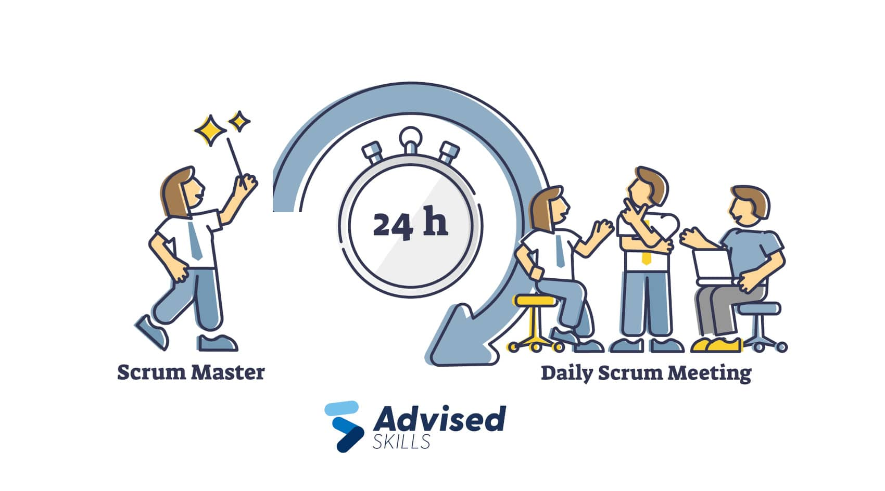
Roles in a Scrum-Agile Team:
The development team consists of experts who gradually supply the product.
The Product Owner specifies features, establishes priorities, and represents stakeholders.
The members of the Scrum Master reduces barriers, promotes teamwork, and guarantees adherence to Scrum principles.

Slide 2


Phases of SDLC in Agile Approach:
Review: During sprint reviews, stakeholders offer input.
Retrospective: The group evaluates the sprint and pinpoints areas in need of development.
Planning: User stories are categorized, ranked, and given an estimated value.
Execution: Development teams follow sprint targets to guide them as they work on user stories.

Slide 3


Contrast with Waterfall Development:
Fewer flexible phases, stringent requirements, less stakeholder participation, and less flexibility.
Iterative procedures, adaptability to change, continuous stakeholder feedback, and flexibility are all part of agile development.

Slide 4


Factors for Choosing Approach:
Waterfall: Appropriate for well-defined projects with stable requirements, limited stakeholder input, and low complexity.
Agile: Suitable for projects with evolving requirements, high stakeholder involvement, and need for rapid iterations.

